Slide 1

WELCOME TO
THE FUTURE OF BANKING
BY ALEX ZHAO, ANUSHA DE, SAAVAN NANAVATI

Slide 2



VOICE CONTROLLED
BANKING
TECHNOLOGY
STACK
FUTURE
STEPS

Slide 3

VOICE
RECOGNITION
IS A $55.1 BILLION INDUSTRY
#market
#future

Slide 4
THE CURRENT
STATE OF BANKING
VOICE TECHNOLOGY IS LIMITED
NFC
Voice recognition technology only sometime works
Speech analysis can fail
Few banks offer this technology
The ones that do don’t offer budget planning options

Slide 5

CitiTalks
IS THE SOLUTION
We took user preferences into account to develop a sustainable and scalable solution to financial wellness and accessible banking problems

Slide 6

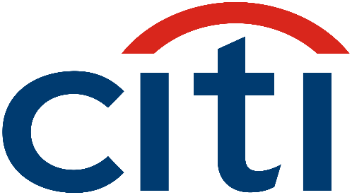
VOICE
CONTROLLED
BANKING
CitiTalks allows customers to access critical bank account information and find out how their planned purchases will impact their outstanding balance.
#creative
#innovative

Slide 7





TECH STACK
PYTHON
NLTK
NLTK
Rev.ai
Backend data analysis, web scraping, integration
Text analysis, POS tagging, tokenization, noise removal
Speech to text translation, with confidence measurements
SpaCy
HTML/CSS
Citi API
Extract relations in text, traverse dependency trees
Website development is mobile-friendly and aesthetic
To access banking information for display & analysis

Slide 8
THE
WEBSITE
IS BEAUTIFULLY WRITTEN
#aesthetic
#mobile
#seniorCitizenFriendly

Slide 9
FUTURE STEPS
Moving forward
Faster algorithm analysis
Location-Based Price Tracking
With better algorithms we can increase response time to the user
To provide prices to consumers based on the specific store they’re in
Develop an Android/iOS application
Add security features
We would like to be accessible directly from our own app or Citi’s app
Through HTTPS protocol, password authentication, 2FA, NFC

Slide 10
THANK YOU

